Slide 1

TIME-WISE-24
Created by –
Nusrat Jahan (C233464)
Tahasina Tasnim Afra (C233456)
Tanisha Chowdhury (C233462)

Slide 2
Purpose:
To help users manage their schedules efficiently with features like class timetables, meal plans, exercise plans, and reminders.
Objectives:
Simplify Scheduling
Enhance Productivity
Promote Healthy Lifestyle
Facilitate Personal Management

Slide 3
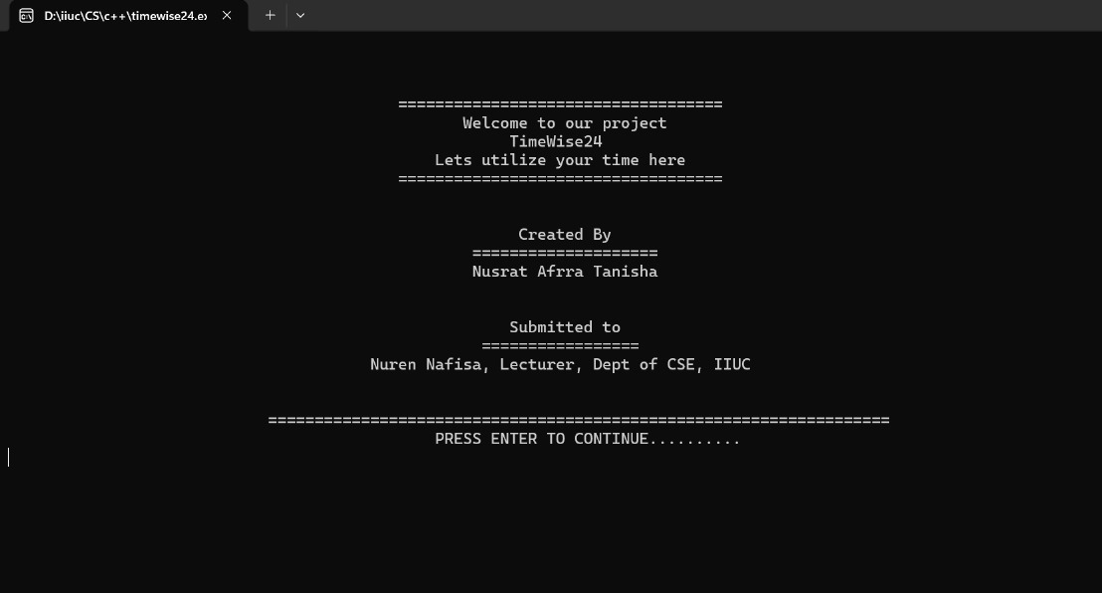
Lets study the console and different features:
Welcome panel

Slide 4
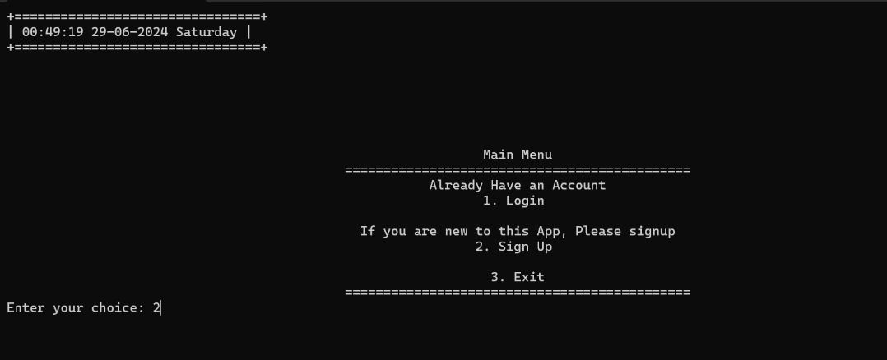
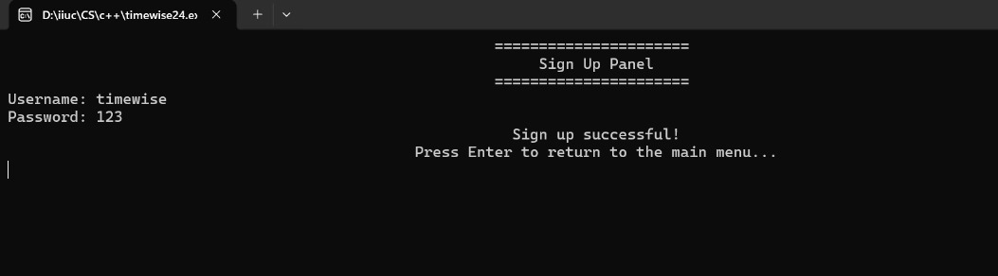
Menu panel
User sign up

Slide 5
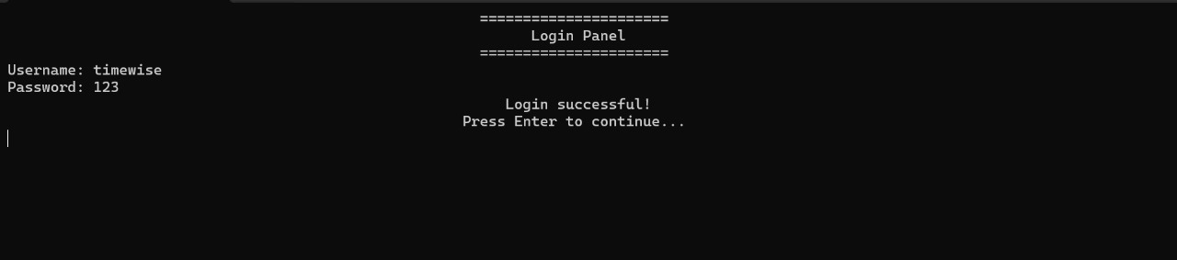
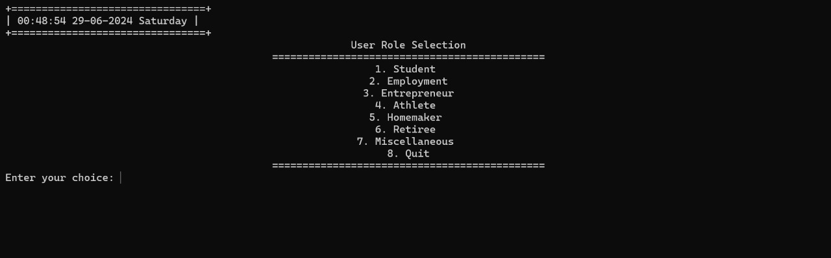
User login
Select user occupation

Slide 6
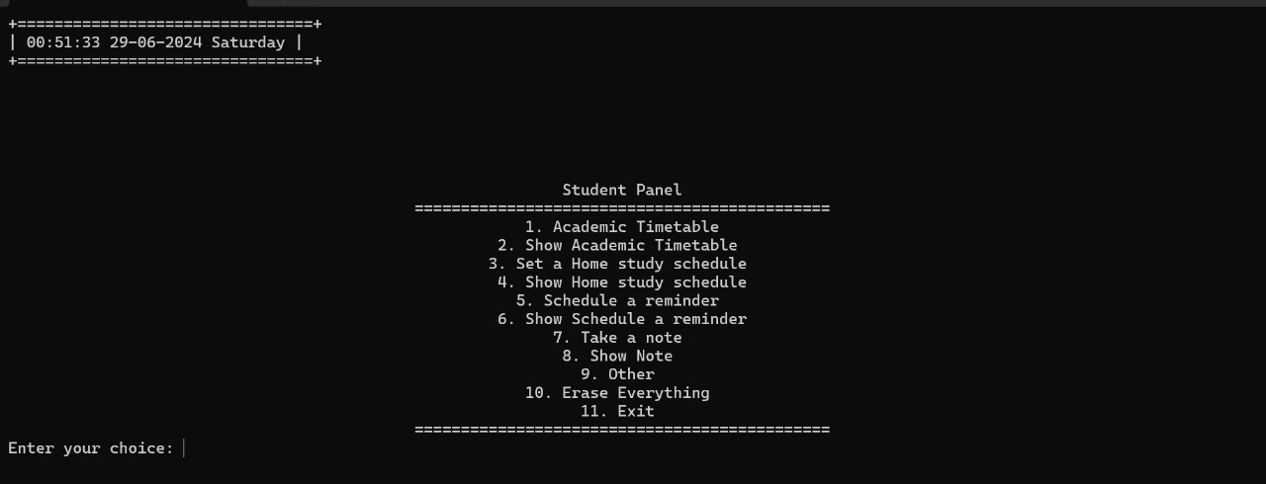
User chooses student

Slide 7
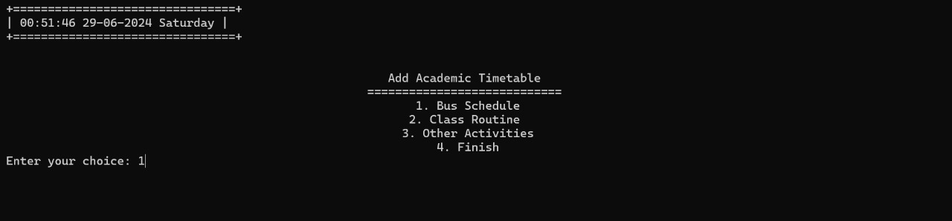
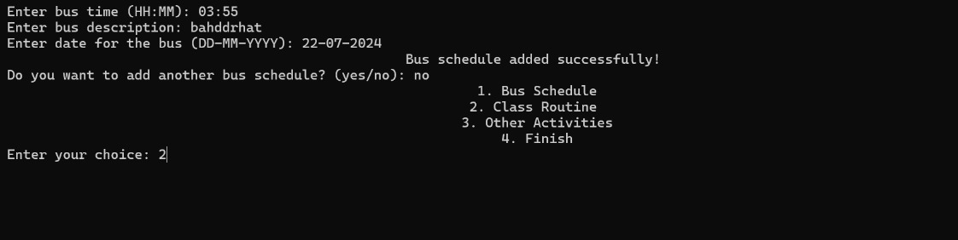
Student can set their timetable…
…and any other activities they would like eg: Bus schedule etc

Slide 8
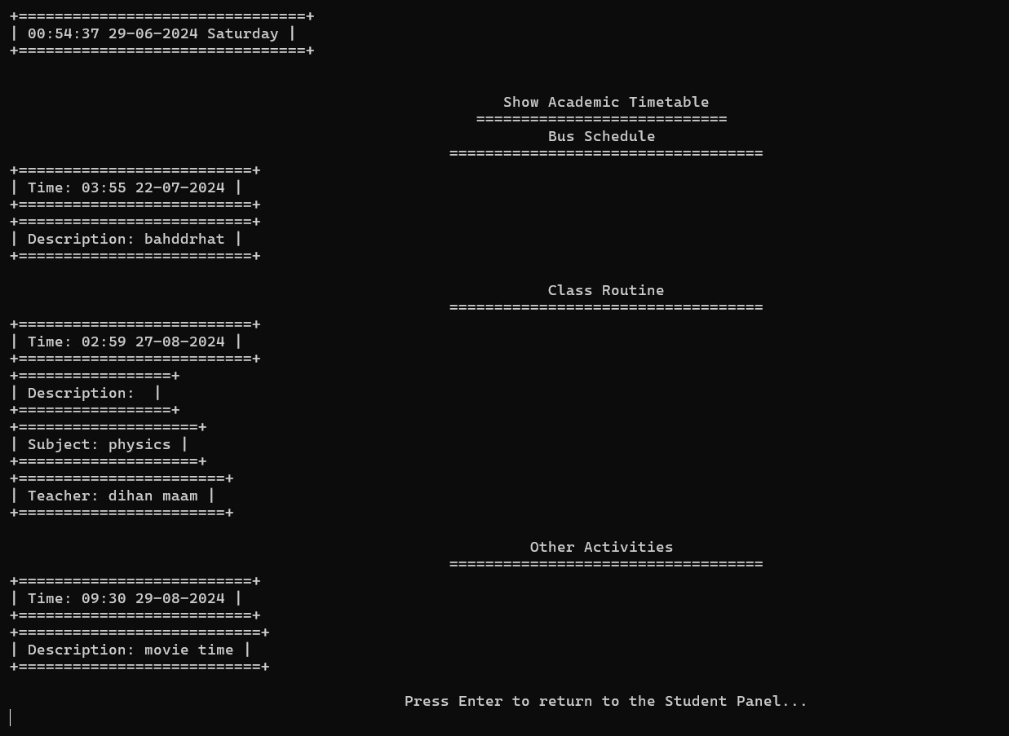
View your given schedule in table format

Slide 9
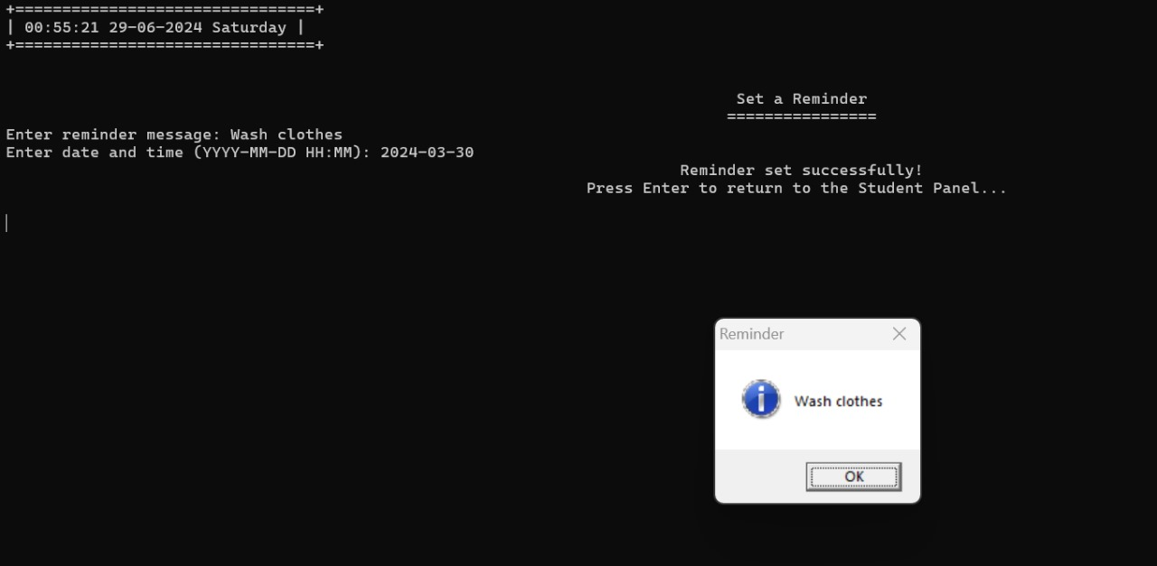
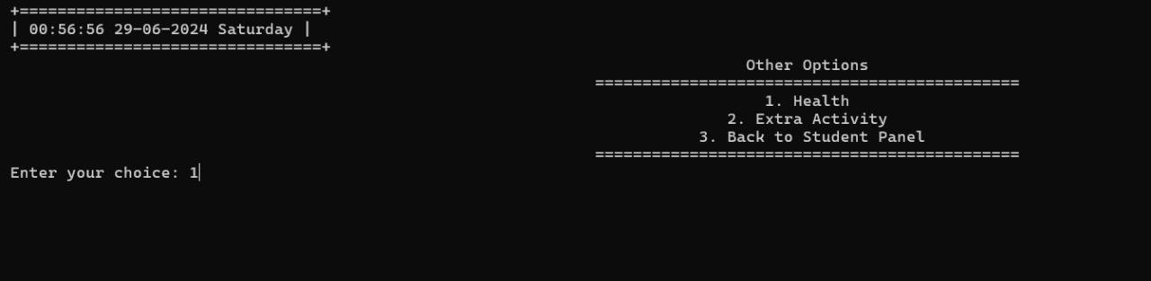
Set up remainders!
Other options include lifestyle related features

Slide 10
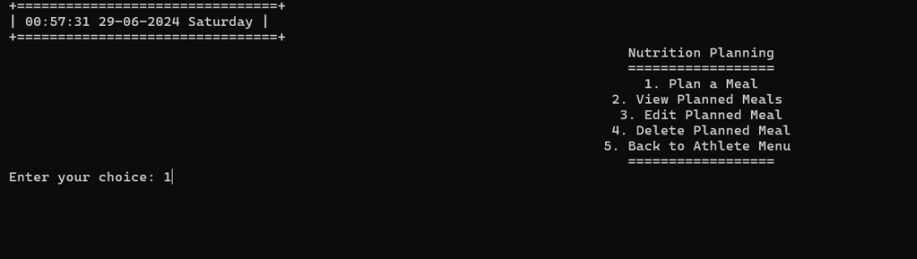
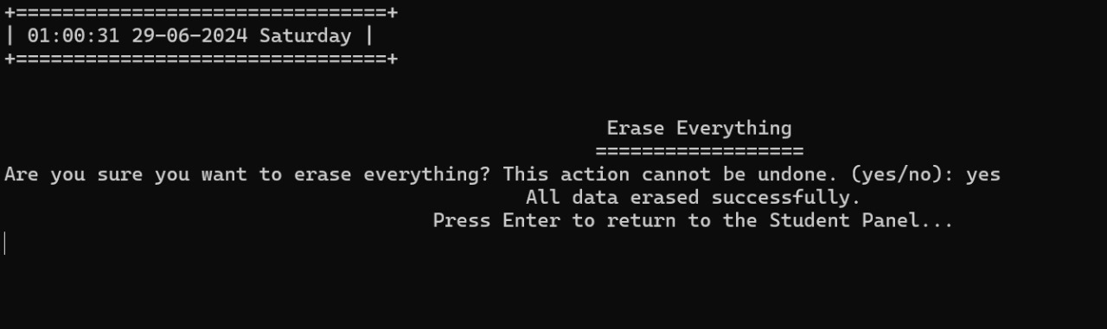
Nutrition panel
You can erase the info you have added so when you view,your schedule remains empty

Slide 11
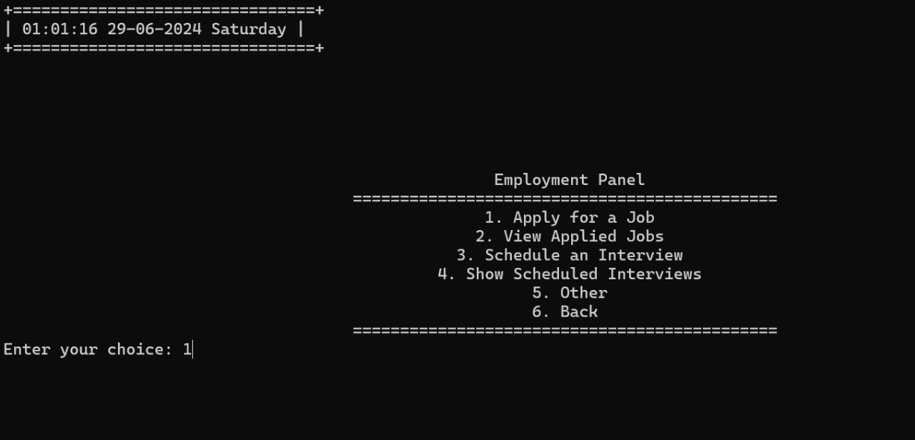
If the user is an employee

Slide 12
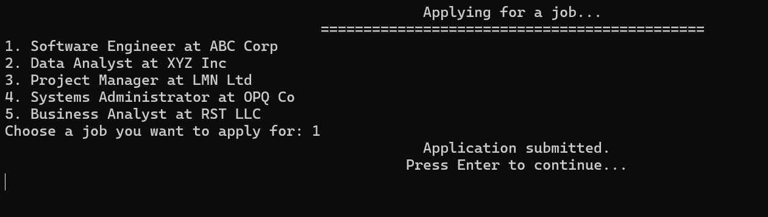
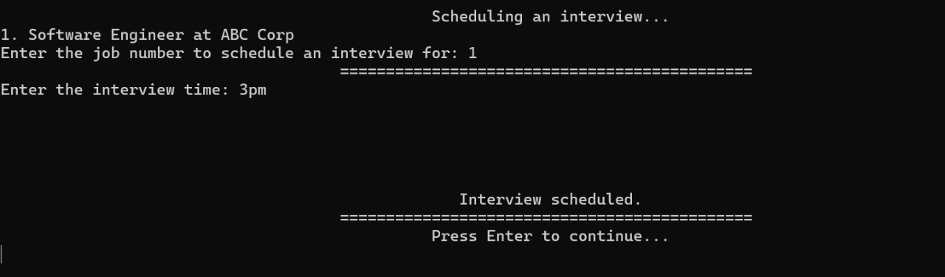
Search for job results and apply
Schedule interview time for chosen job

Slide 13
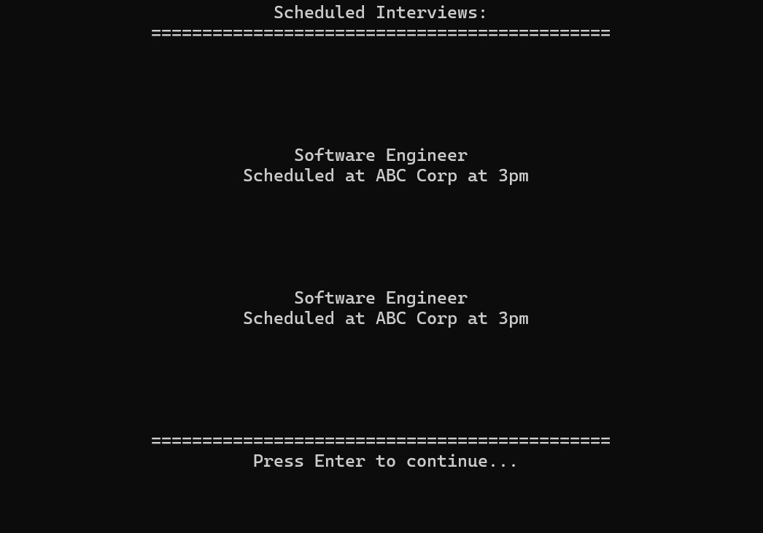
View schedule of the employee

Slide 14
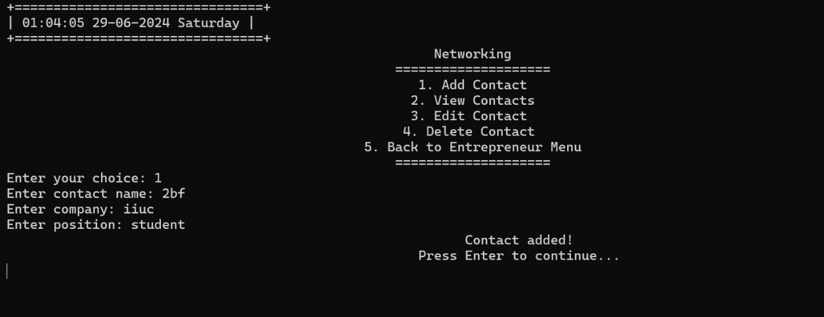
The employee can record contacts of other people they meet

Slide 15
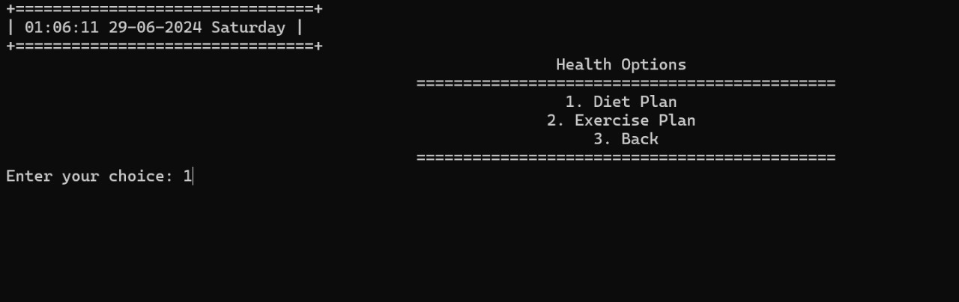
One main objective is Health tracking !

Slide 16
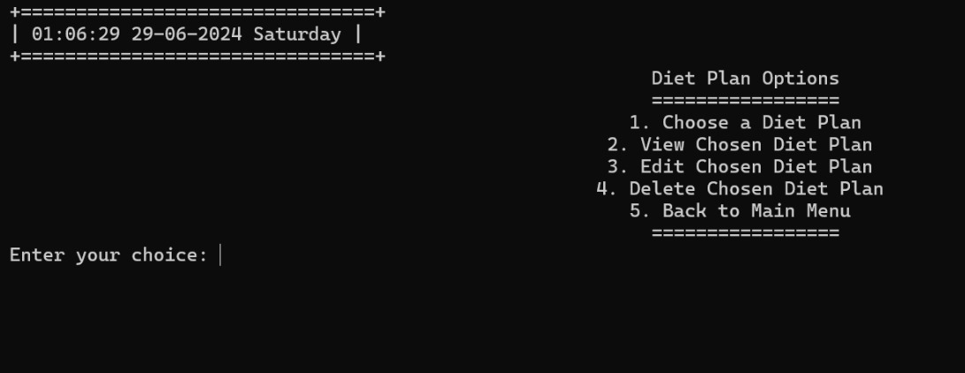
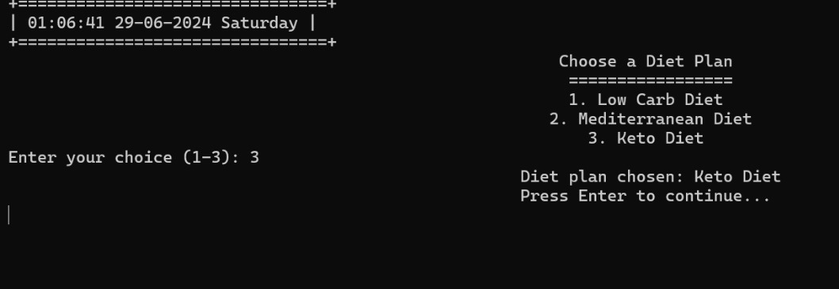
Diet plan for a fit lifestyle
You can choose what kind you prefer

Slide 17
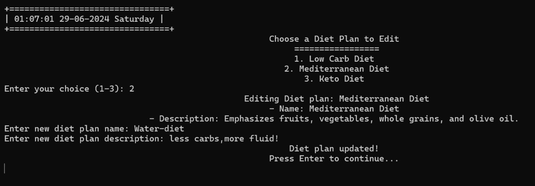
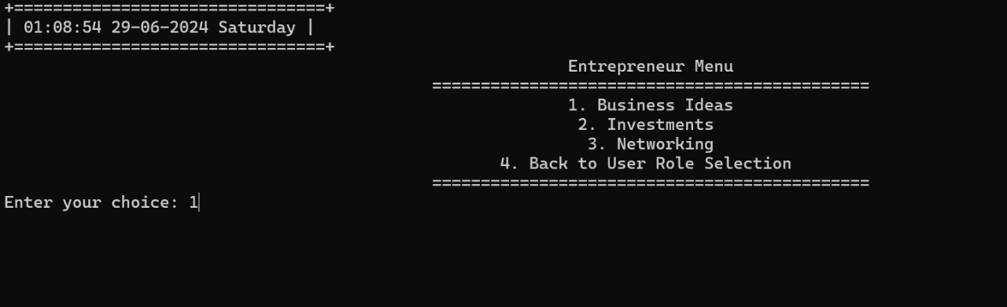
Update and replace your diet plan
User is an entrepreneur!

Slide 18
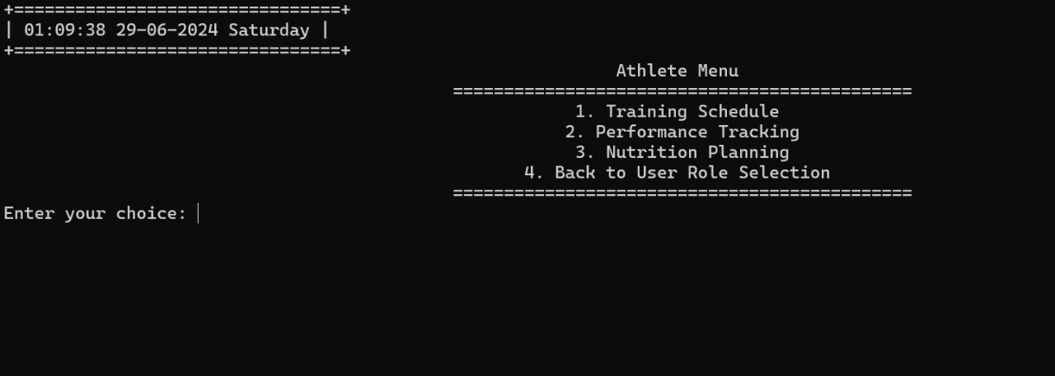
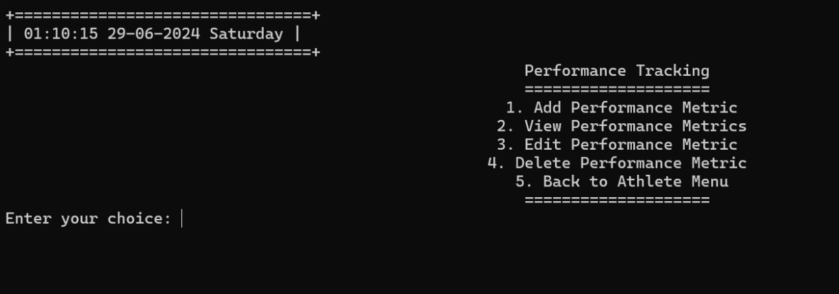
For the athletes
keep track of your productivity

Slide 19
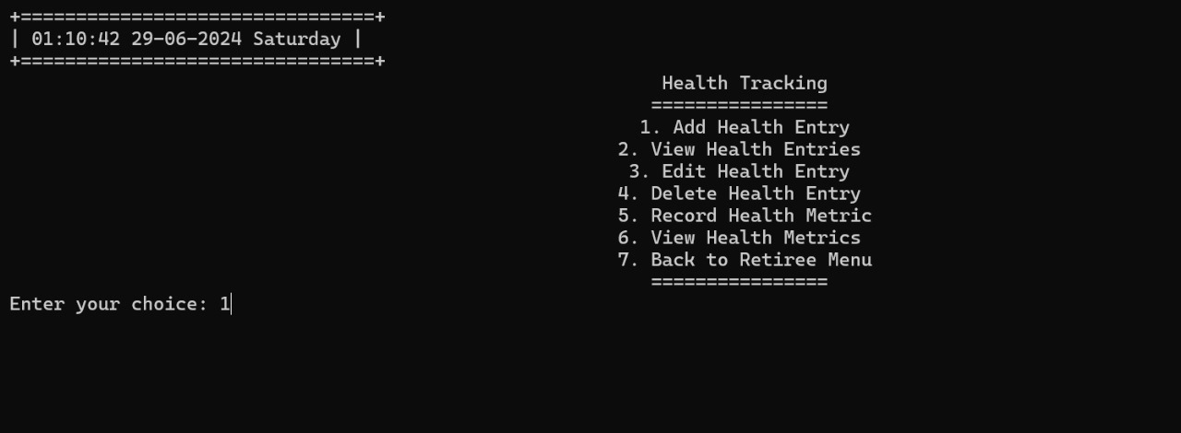
Record your health metrics

Slide 20
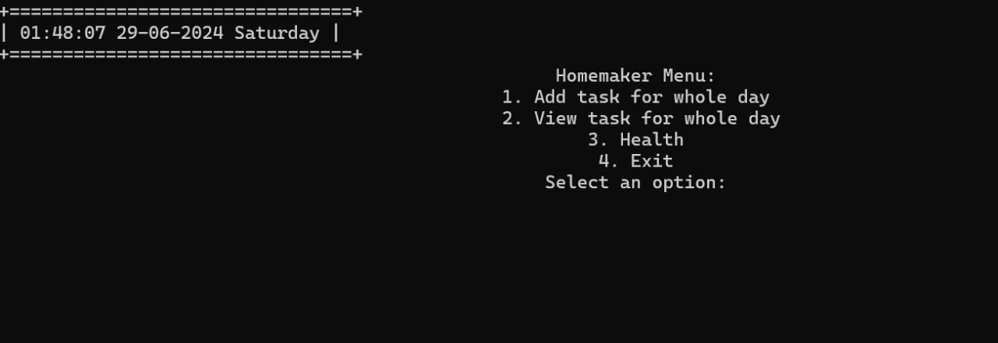
The homemaker panel applies the same features too

Slide 21
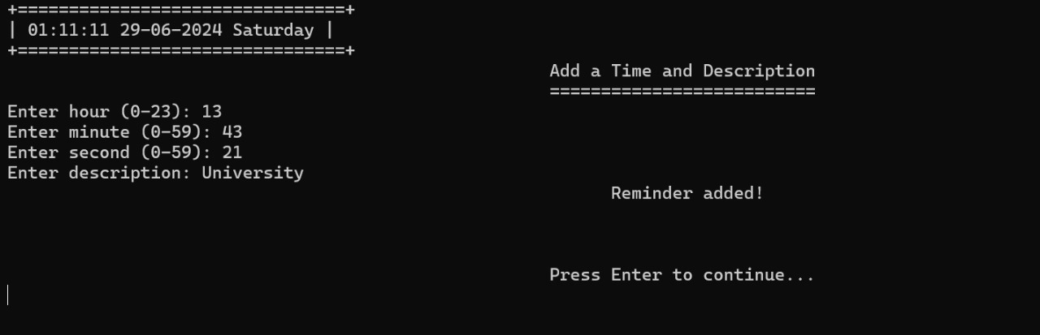
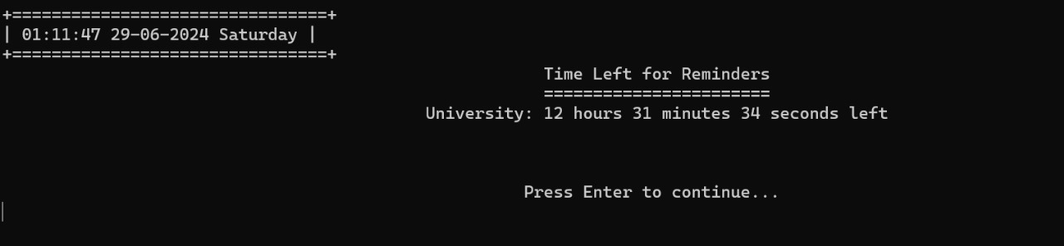
An alarm…
...which will call you at the time of your given task. It shows you the time left for the task to be performed.

Slide 22
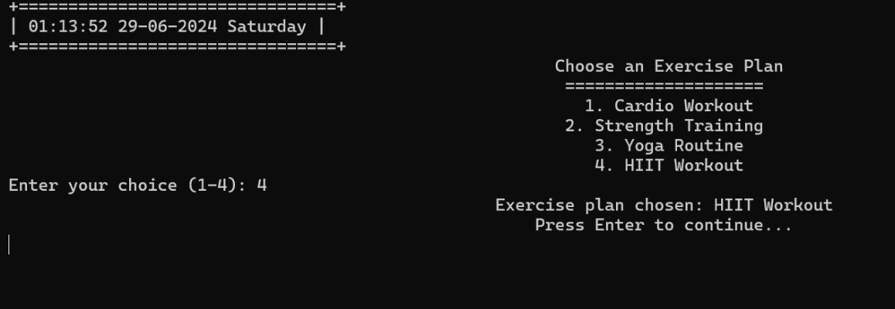
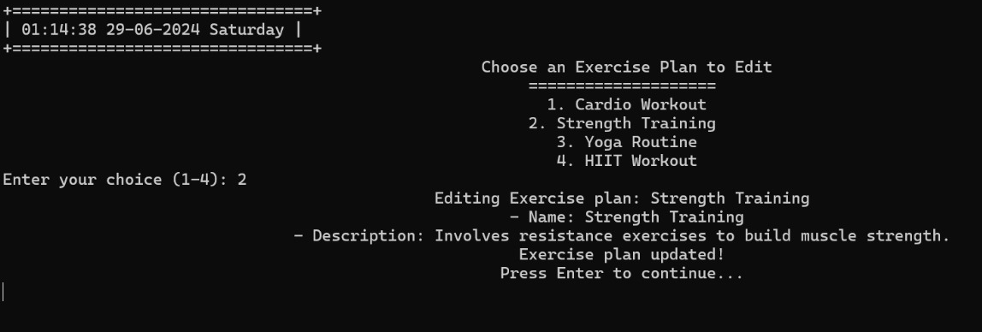
Manages exercise plans, offering functionalities to choose, view, edit, and delete exercises.

Slide 23
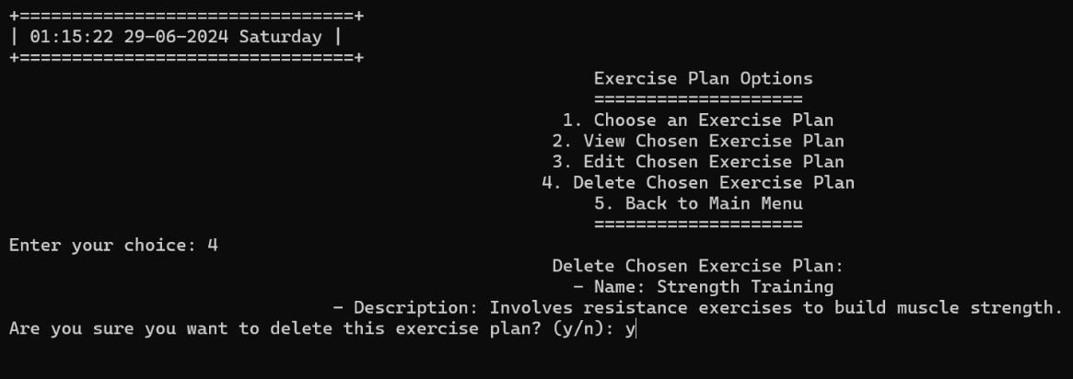
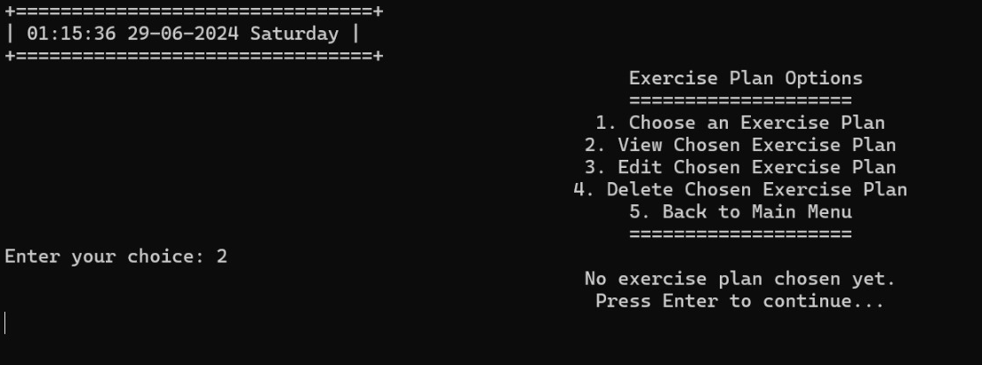
You can even delete what you have previously chosen
The data gets erased and thus when you view it shows no record

Slide 24
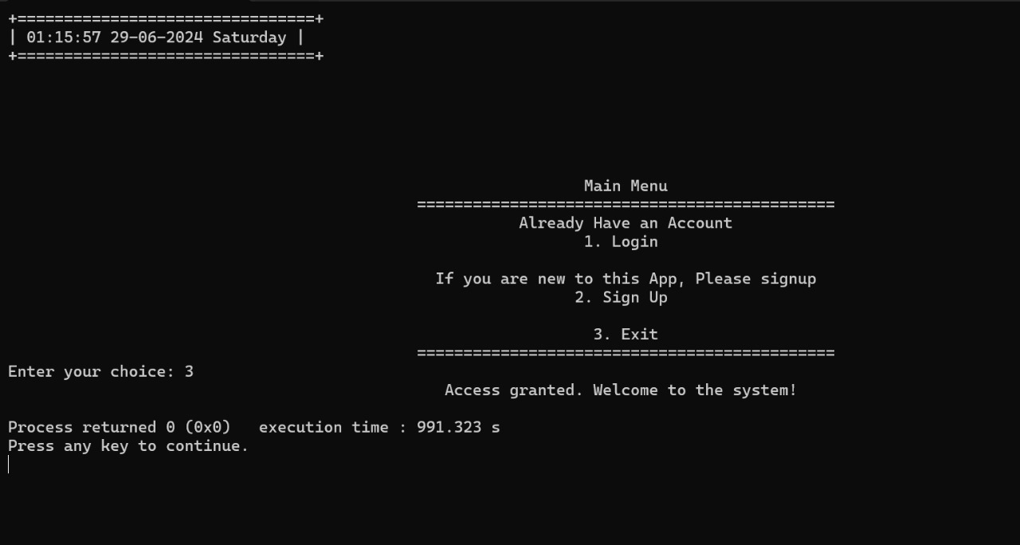
Finally the exit function that will leave the app~

Slide 25
COMPONENTS:
TimeWise24 supports users across various occupations by offering tools for effective schedule management, reminders, health tracking, and personal notes, enhancing productivity and well-being for all.
User Authentication
Sign-Up : Allows users to create new accounts.
Login : Validates user credentials to access the application.
Timetable Management
AddClassRoutine(vector<TimetableEntry>& classRoutine) : Function to add and manage class schedules.
showAcademicTimetable(const string &username) : Displays the academic timetable for the logged-in user.
addMealTimetable(vector<TimetableEntry>& mealTimetable) : Manages meal schedules including breakfast, lunch, snack, and dinner.
showMealTimetable(const string &username) : Displays meal schedules in a 24-hour format.

Slide 26
COMPONENTS:
3. Daily Schedule Viewing
viewDailySchedule(const string &username): Provides a comprehensive view of the daily schedule, integrating class and meal timetables.
4. Reminders and Alerts
setReminder(const string &username): Allows users to set reminders for classes, meals, or other tasks. You can also see them with the showReminders-function.
checkReminders(const string &username): Checks upcoming reminders and notifies the user.
5. Diet and Exercise Plan Management
handleDietPlan(): Manages diet plans, allowing users to add, edit, and delete diet options.
handleExercisePlan(): Manages exercise plans, offering functionalities to choose, view, edit, and delete exercises.

Slide 27
Connecting to Reality:
Imagine starting your day with TimeWise24~
Morning: Wake up to a reminder for your morning exercise.
Midday: Get a nudge to drink water and stay hydrated.
Afternoon: Follow your diet plan with pre-set meal reminders.
Evening: Review your health notes and plan for the next day.

Slide 28
THANK YOU

